Slide 1
Spain E-invoicing Campaign Page

Slide 2
FOLD 1 — HERO
Eyebrow: SPAIN B2B E-INVOICING
Header: Spain E-Invoicing: There’s More Than Meets the Eye.
Sub copy: What you see is just the tip of e-invoicing iceberg.
Paragraph: The mandate may look like one deadline in 2027-28. Deadline is only the beginning. The real complexity sits underneath the tip of the iceberg - SII, Crea y Crece, VeriFactu, Invoice-status reporting, and data flows.
Understand what applies to your business, clear the myths, and how to integrate compliance layer for what's coming next.
CTA: Get Spain E-Invoicing Clarity
Lead form on the right side

Slide 3
FOLD 2 — TRUST
Header
Trusted by 6000+ Enterprise Across 50+ Countries
Then logos.

Slide 4
FOLD 3 - MYTHS VS REALITY
Header: Spain E-Invoicing Myths That Can Cost You
Para: Spain brings together multiple compliance layers - each with its own scope, data and reporting requirements. That's where the complexity starts and breeds myths around the mandate. Let’s clear the air about the mandate.
MYTH 01: “We’re already SII-compliant. We’re not covered in Spain’s e-invoicing.”
REALITY content on left side: —-------- Graphic idea on right side: Two parallel cards:
vs.
B2B E-INVOICING
Invoice
↓
Customer
↓
Status
↓
Payment information
SII
Invoice records
↓
AEAT

Slide 5
Flip the sides of graphic and content
MYTH 02: “SII makes both sides report VAT.
Crea y Crece does the same.
(We don’t need to do anything new.)
”
REALITY content on right side: —-----------------------------
Graphic idea on left side::
SELLER
Issue → Send
↓
BUYER
Receive → Accept/Reject → Pay
↓
AEAT / PUBLIC SOLUTION
Status + payment information

Slide 6
Flip the sides of graphic and content
MYTH 03: “An invoice with a QR code, makes us e-invoicing compliant!”
REALITY content on left side: —-----------------------------
Graphic idea on right side::

Slide 7
Flip the sides of graphic and content
MYTH 02: “The buyers only have to report when an invoice is clearly accepted, rejected, or paid.”
REALITY content on left side: —-----------------------------
Graphic idea on right side:
→
There are 7 more myths on E-Invoicing that we have cleared the air about in our report.
CTA: Download Myth vs Facts
Buyer
Accept
Reject
Paid
Partial acceptance
Payment term changed
Report to Government within 4 days of event
(silence is presumed acceptance)

Slide 8
Fold 4th: Spain E-invoicing made easy
Header: One Invoice. Two Compliance Flows. Multiple Reporting.
Sub copy: SII and Crea y Crece don't replace each other. They operate on different parts of the invoice lifecycle.
Graphic ideas on next 2 slides:

Slide 9
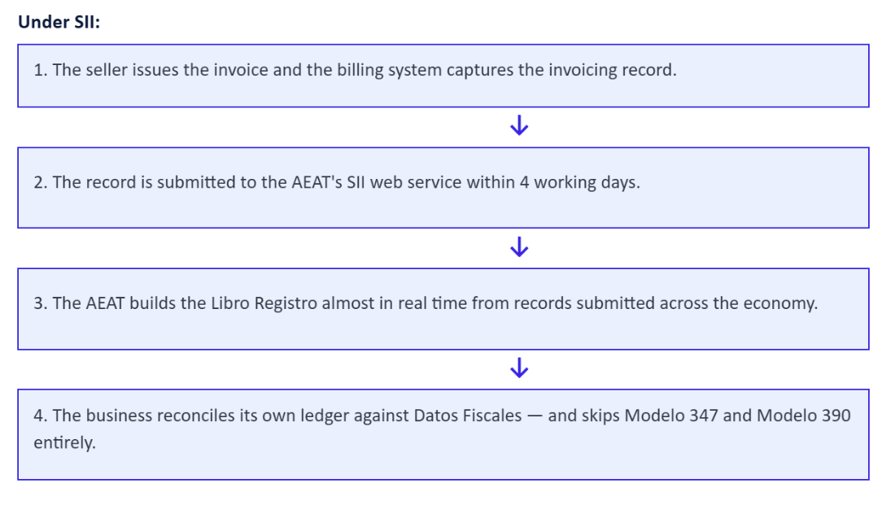
See how invoices move end to end
Your invoice journey under SII:

Slide 10
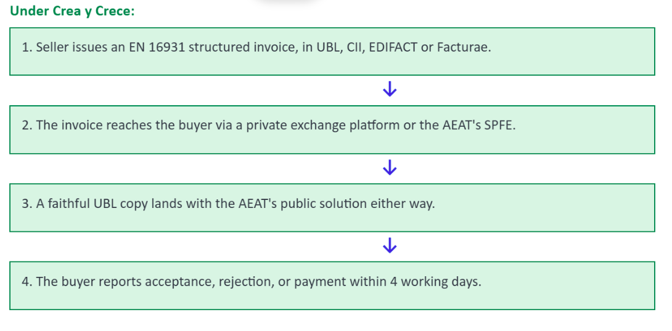
Left side: Your invoice journey under Crea y Crece

Slide 11
SII - VAT reporting to AEAT
Who?
Large businesses, VAT groups, REDEME and other specified taxpayers.
What?
Invoice-record information.
Crea y Crece - B2B E-Invoicing
Who?
Businesses and professionals within the scope of the B2B e-invoicing framework.
What?
Structured electronic invoices and invoice-state/payment information.
CTA: Get the full Spain compliance playbook

Slide 12
Fold 10: Everything you need
Header: Header: How ClearTax Saves You From the Iceberg?
Sub copy: Manage Compliance with Confidence.
Crea y Crece ready before the mandate lands | A registered Peppol Access Point | SII and Crea y Crece on one platform
Issue and receive EN 16931 invoices in UBL, CII, EDIFACT or Facturae. Accept, reject and paid events are captured and reported inside the four-day window. | Exchange electronic invoices securely through the Peppol network, interoperable with the AEAT's public SPFE. | Generate and submit accurate Libros Registro to the AEAT within the four-day SII deadline, with built-in reconciliation against Datos Fiscales.
One platform across 50+ countries | Works with the ERP you already run | Scales with your invoice volume
Run every e-invoicing mandate through one platform and API. Each new country needs only configuration. | Connect your ERP, billing system or OMS to our platform through certified, prebuilt connectors, API or SFTP. | Enterprise invoice volumes grow and spike. ClearTax keeps up, and auto-healing validations catch errors before a submission fails.

Slide 13
Fold 10: ClearTax
Iconography
A dedicated local expert from kickoff to go-live
A dedicated ClearTax expert in your market guides your implementation and stays with you as requirements change.
Mandate changes don't land on your IT team
Spain's rules are still moving. ClearTax updates the platform when they change, so your team doesn't re-implement.
Independently audited security
SOC 2 Type II and ISO 27001:2022 audited controls, third-party security testing, role-based access, and encryption in transit and at rest.
Independently audited:
ISO 27001:2022
SOC 2 Type II
GDPR-ready
AES-256 encryption at rest
3rd party VAPT

Slide 14
Ready to evaluate your Spain readiness?
Get a personalised gap assessment across Crea y Crece and SII, mapped to your ERP, before the phase-in countdown begins.
CTA: Talk to us

Slide 15
Next fold
Header: What’s the difference in four-day deadlines under SII and Crea y Crece?
Para: Both say "four days," but they're different obligations, with different triggers, doing different jobs.
 | Crea y Crece - status reporting | SII - VAT reporting
What it is | Report the invoice's commercial status | Report invoice VAT data to the tax ledger
The scope/applicability | The recipient (buyer) (mainly large firms, >€8M turnover) | The taxpayer issuing/receiving (mainly large firms, >€6M turnover)
Trigger event | A status event - rejection date, or effective payment date | Issuing or receiving the invoice
The four days | 4 days, excluding weekends & national holidays | 4 days, excluding weekends & national holidays
Status today | Not yet in force - activates with the Ministerial Order (projected 2027/2028) | Live since 2017
Purpose | Exposes late payments, track the payment lifecycle | Give AEAT near-real-time VAT visibility

Slide 16
Fold 6th: THE CFO QUESTION
Header: How Many Compliance Clocks Are You Running?
Sub copy: The same invoice can create more than one reporting event.
Graphic idea: show three clocks
CTA: See the full Spain compliance playbook
CLOCK 01
Invoice issued
SII reporting timeline
CLOCK 02
Invoice received / processed
SII reporting timeline where applicable
CLOCK 03
Invoice accepted / paid
B2B invoice-state and payment reporting

Slide 17
FOLD 3 - It's Not Just E-Invoicing
Header: Think Spain E-Invoicing Is Just About Sending Structured Invoices?
Sub copy: That's where the complexity starts.
Para: For many businesses, Spain brings together multiple compliance layers - each with its own scope, data and reporting requirements.
Graphic idea: A large central invoice/card: YOUR INVOICE in the center
Around the invoice graphic: floating icons of
SII
B2B E-INVOICING
INVOICE STATUS
VERIFACTU
Then below: One invoice. Multiple compliance questions.

Slide 18
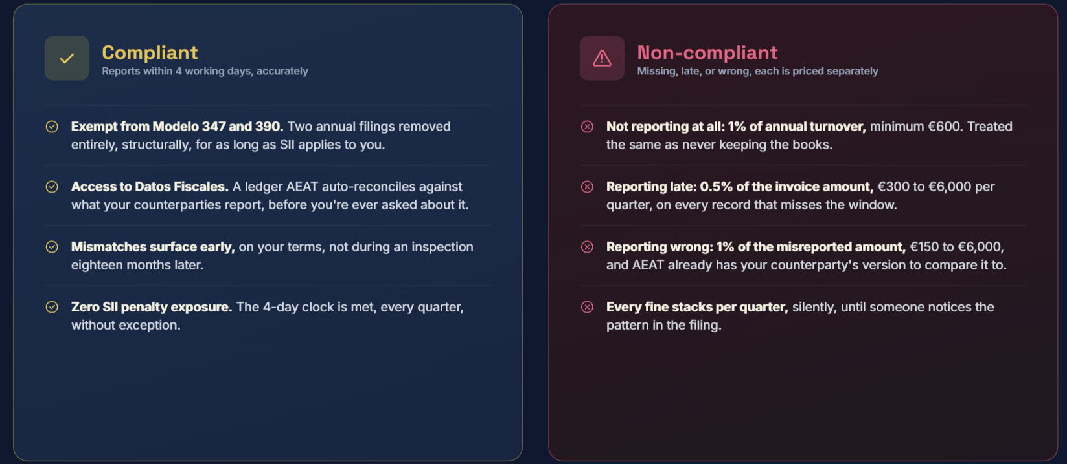
Fold 10: Header: What if You’re Not Compliant with SII.
Note to consider: Being legitimately outside SII is not “SII non-compliance.” The question is whether the particular taxpayer is obliged to keep the relevant register through the competent authority’s SII system.

